Slide 1

Software development lifecycle
Applying Agile framework and Scrum methodology

Slide 2
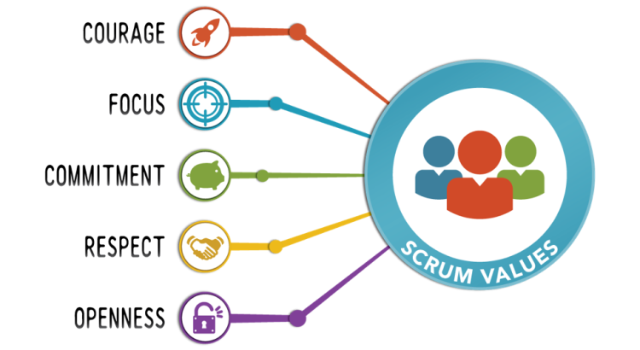
The scrum team
The Product Owner represents the business sponsor. They contribute to the team by managing the Product Backlog and maximizing the value of the finished product.
The Scrum Master is the servant-leader of the team. They facilitate the Scrum structure and ideology throughout the project.
The Developers and Testers are responsible for creating usable increments each Sprint, as defined by them. They work collectively to achieve the "Definition of Done" for each Sprint goal. (Schwaber & Sutherland, 2020)
This Photo by Unknown author is licensed under CC BY-SA.

Slide 3
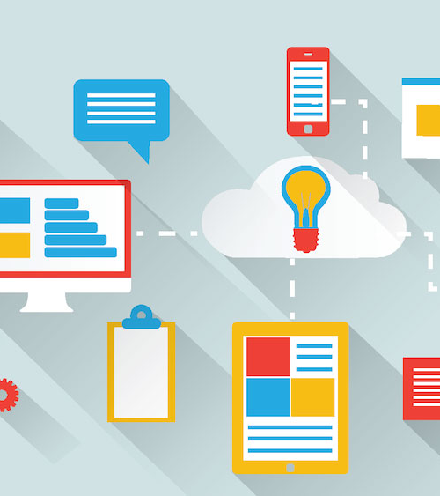
SDLC and Agile
The agile framework relies heavily on client input and collective teamwork. The software development lifecycle happens through iterations of the following process:
Planning
Requirement Analysis
Design
Coding
Unit Testing and Acceptance Testing
The team prioritizes select increments of the build to focus on. User feedback is solicited through numerous iterations of development and testing.
The result is deliverable, functional software at the end of each sprint. The final product is the culmination of all increments.
A review is held with the stakeholders, and a retrospective is held with the scrum team following launches.
Receiving feedback and exploring the successes and failures of the project provides invaluable information to apply to future projects.
("SDLC – Agile Model", 2017)
This Photo by Unknown author is licensed under CC BY-SA-NC.

Slide 4
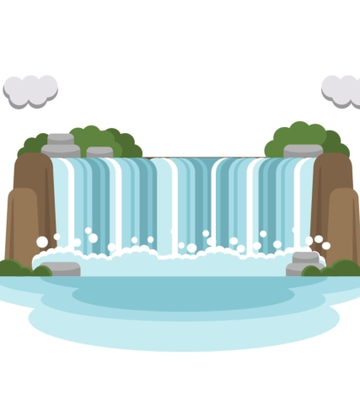
The Waterfall Method
The waterfall method has been regarded as the standard for software development for many years. Important factors to consider about this process are:
work does not begin until the project specifications have been agreed upon and documented from beginning to end.
Once the team begins work, there is no further client collaboration. The team moves through the process of requirement analysis, system design, implementation, testing, and deployment.
There is only one iteration of this process.
If the client rejects the finished product and/or there are integral issues found while testing – the project reverts to the planning phase – costing time, money, the confidence of the team, and the satisfaction of the client.
("SDLC – Waterfall Model", 2017)
Had our team used this framework for the SNHU Travel project, I believe it would have resulted in overwhelming failure. The requests we received mid-development concerning fundamental changes to the software would not have been known until deployment, potentially resulting in losing the client altogether.
Photo Source: https://ak.picdn.net/shutterstock/videos/1049951068/thumb/9.jpg

Slide 5
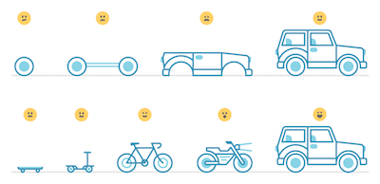
Agile vs waterfall
When deciding which framework is best suited for your project, you should ask yourself a few questions.
Do you anticipate redirection and the need to adapt throughout development?
Is a high level of documentation required?
Does the project have a rigid scope, budget, and timeline?
Can the project be accomplished in a timely manner with only a small team?
(Ray, 2020)
This Photo by Unknown author is licensed under CC BY-SA.
During this course, I have found the process of software development to require fluidity, ingenuity, and persistent momentum. For this reason, I highly endorse the implementation of a scrum-agile methodology.
While time and budget estimations can be less precise, working collaboratively and iteratively allows room for experimentation, failure, and creativity – which ultimately results in a finished product with a truly maximized value.

Slide 6
Resources
Ray, A. (2020, September 30). Agile vs. Waterfall. Capital Numbers. https://www.capitalnumbers.com/blog/agile-vs-waterfall-which-development-methodology-should-you-choose/
Schwaber, K., & Sutherland, J. (2020). The 2020 Scrum Guide. Scrum Guides. https://scrumguides.org/scrum-guide.html
SDLC – Agile Model. (2017). Tutorials Point. https://www.tutorialspoint.com/sdlc/sdlc_agile_model.htm
SDLC – Waterfall Model. (2017). Tutorials Point. https://www.tutorialspoint.com/sdlc/sdlc_waterfall_model.htm

